Slide 1


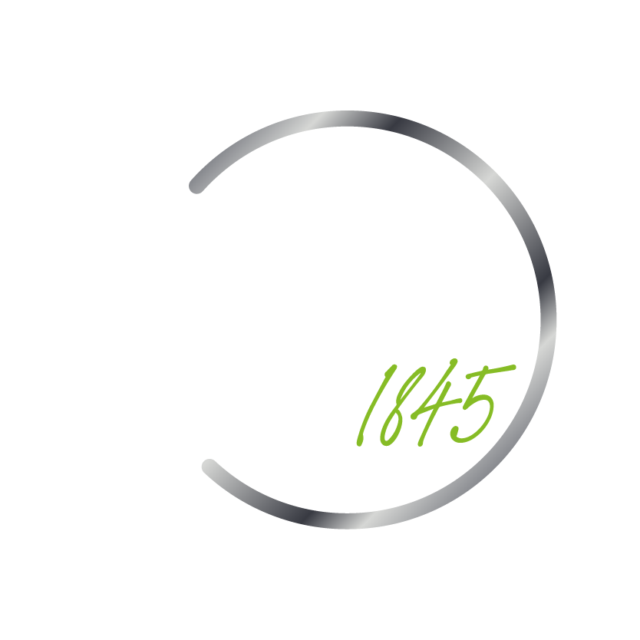
CONCEPT NOTE – NEED FOR ENHANCED RESILIENCY MEASURES IN INDIAN POWER SECTOR
© Deloitte Touche Tohmatsu India LLP | April 2025

Slide 2


Continued Power Sector Infrastructure Losses from Natural Catastrophes
Continued asset losses from inevitable natural catastrophes over the years have emerged as a key challenges for the power sector utilities
Many cases available across several news articles, blogs, post, reports and other literature indicates the high vulnerability of power sector assets in case of events like glacier burst, flood, cyclone, storm, excessive heats, earthquakes, forest fires, among others
“Storm knocks out power, causes heavy infra damage in Ludhiana”
(May 2019 – Times of India)
“Tripura: Restoration efforts underway after storm destroys Rs 1.22 crore power infrastructure”
(May 2024 – India Today)
“More than 9,700 Crores of power infrastructure damaged due to cyclones in Odisha between 1999-2019”
Electrical India Article
“Cyclone Gaja (2018) in TN destroyed 86,000 poles, 800 transformers and 200 substations leading to total electrical infra damage of ₹10.5 billion (US$120.5 million)”
“Cyclone Amphan resulted in large scale power sector asset infrastructure losses in West Bengal, Odisha and Bangladesh”
- NDRF
“Delhi and Haryana Heatwave and Surge in Fires leads to more electrical failures”
- Reuters
“Karnal: Flash flood leaves 128 transformers, 105 poles damaged”
(July 2020 – Tribune India)
“Weekend rain brought down 546 electricity poles, 64 transformers in Bescom jurisdiction”
(May 2023 – The Hindu)

Slide 3

From Blackouts to Breakthroughs: Reinventing the Grid for a Sustainable Tomorrow
Heavy losses of power sector from natural events necessitates exploration and inclusion of resilient mitigation measures
“It is imperative for the sector to explore innovative solutions guarding its electrical assets against natural catastrophes…”
One of the potential solutions is integrating the Fixed Asset Register (FAR) with GIS and Climate datasets. While FAR gives records of assets, climate details with aid in informed decisions to minimize losses
Key Risks / Challenges necessitating need for enhancing resiliency of power sector
High Economic Losses from damage of electrical components across the value chain
Economic losses negatively impact the financial performance of the
power sector utilities
How will FAR integrated with climate datasets help the sector?
 | Identify the assets placed in high-risk zones (floodplains, coastal belts, landslides-prone areas, etc.)
 | Use the details to devise maintenance alerts (both preventive and predictive
 | Shut down vulnerable spots in advance to reduce blackouts and easy ramp-up post disaster
 | Climate tagged FAR will indicate need for insurance of assets in highly vulnerable areas
 | Optimized capital allocation for reinforcements based on high, medium and low risk zones
Breakdowns, major blackouts and Outages pose as a major threat to
reliable and uninterrupted power to citizens
Renewables sources like solar, wind and hydro are more vulnerable to
natural disaster given their direct connect with the environment
Capital Intensive power assets require very high Repair & Maintenance
(R&M) cost upon damage
Some of the global climate related tools which can be leveraged include Pythias, GEONETCast and Climate Risk Informed Decision Analysis (CRIDA)

Slide 4
Few Global Case Studies
Seeking global perspective to evaluate some success stories and inherit key offerings
Pamir Energy (Tajikistan): Strategic Asset Placement Using Hazard Analysis
In Tajikistan, Pamir Energy utilized hazard sensitivity analysis and numerical modeling to strategically place transmission towers away from avalanche paths. By integrating climate risk assessments into their infrastructure planning, they ensured reliable power supply to remote communities while mitigating disaster risks
https://blogs.worldbank.org/en/energy/building-resilient-power-grids--integrating-climate-and-disaster?
National Grid Electricity Transmission (UK) – Flood Risk Integration
National Grid Electricity Transmission (NGET) partnered with Previsico to integrate real-time flood forecasting and sensor data into their asset management systems. This collaboration enabled NGET to assess environmental risks at the asset level, particularly for substations, allowing for proactive measures against fluvial and surface water flooding. The integration streamlined operations by reducing manual assessments and enhancing decision-making during extreme weather events
https://previsico.com/case-studies/environmental-risk--assurance-to-ngets-assets
Fort Pierce Utilities Authority (USA) – GIS-Based Hurricane Response
Located on Florida's eastern coast, Fort Pierce Utilities Authority (FPUA) faced challenges in managing storm damage and power restoration. By implementing a Geographic Information System (GIS)-based solution, FPUA digitized damage assessments, work assignments, and restoration tracking. This system improved situational awareness, optimized resource allocation, and expedited power restoration efforts during hurricanes
https://www.esri.com/en-us/lg/industry/electric-and-gas/stories/fpua-case-study
Harmonizing & decentralizing network data access, Japan
Japanese power giant TEPCO has addressed frequent storm and typhoon damage by harmonizing and decentralizing network data access, providing end-to-end visibility to vital network data for everyone across both office and the field, allowing them to react quickly and efficiently.
TEPCO deployed a decentralized, mobile-friendly platform which could easily be accessed and updated by field workers, creating a comprehensive and accurate view of not only the grid damage, but potential future hazards.
https://www.geoconnexion.com/publication-articles/the-key-to-disaster-resilient-grids-of-the-future?utm_source=chatgpt.com

